Slide 1
Welcome
Mentoring to Widen Access - Working Group – 24.03.2021

Slide 2
Breakout room
Informal small group discussions to share current successes and challenges with peers. These group discussions are intended to offer continuity between meetings to support colleagues through the current demands of working in this arena.
In your breakout rooms please introduce yourselves
Your role
Your favourite childhood sweet
The thing that you are enjoying most while working from home
The one thing that you are looking forward to when restrictions are lifted

Slide 3
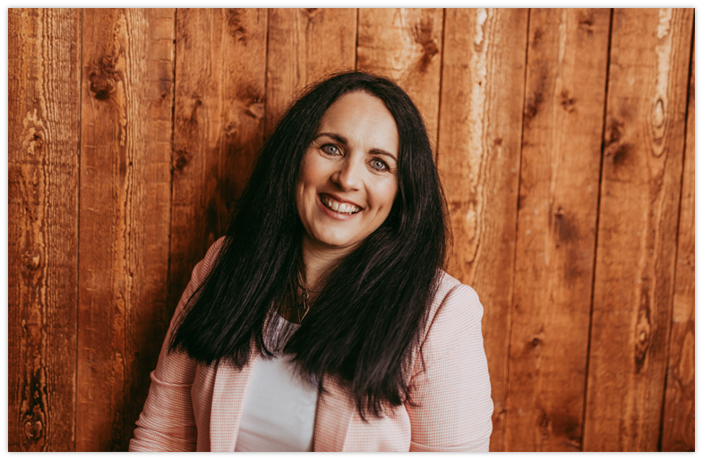
Trish Nicolaides
Mentoring to Widen Access - Working Group – Co-Chair

Slide 4
Current Role
Head of Lifecycle – Widening Participation and Social Mobility – University of Southampton

Slide 5
Additional Roles
University of Southampton - University of Sanctuary working group – Co-chair
Widening Participation and Social Mobility Coordination Group - Sponsor
Westover Primary School Governor – Governor responsible for SEND & Safeguarding
NEON (National Education Opportunities Network) Mentoring to Widen Access – Co-Chair

Slide 6
Mentoring Journey
Students Supporting students
University of Chester
Creation, design and delivery of a range of University peer mentoring schemes: Induction, Computer, International
ESF Mature student mentoring scheme
EAZ in school mentoring schemes
Excellence Challenge
Tiered mentored scheme
University of Portsmouth
National Mentoring Pilot Project – University of Portsmouth lead
EAZ in school mentoring schemes
Routes into Languages Email mentoring
Maths mentoring year 10
Aimhigher Associates
Aimhigher Hampshire & IOW FE mentoring
Notes:
My journey in educational support has been due to my skills and inclination towards listening and care giving with a strong sense of creativity.

Slide 7
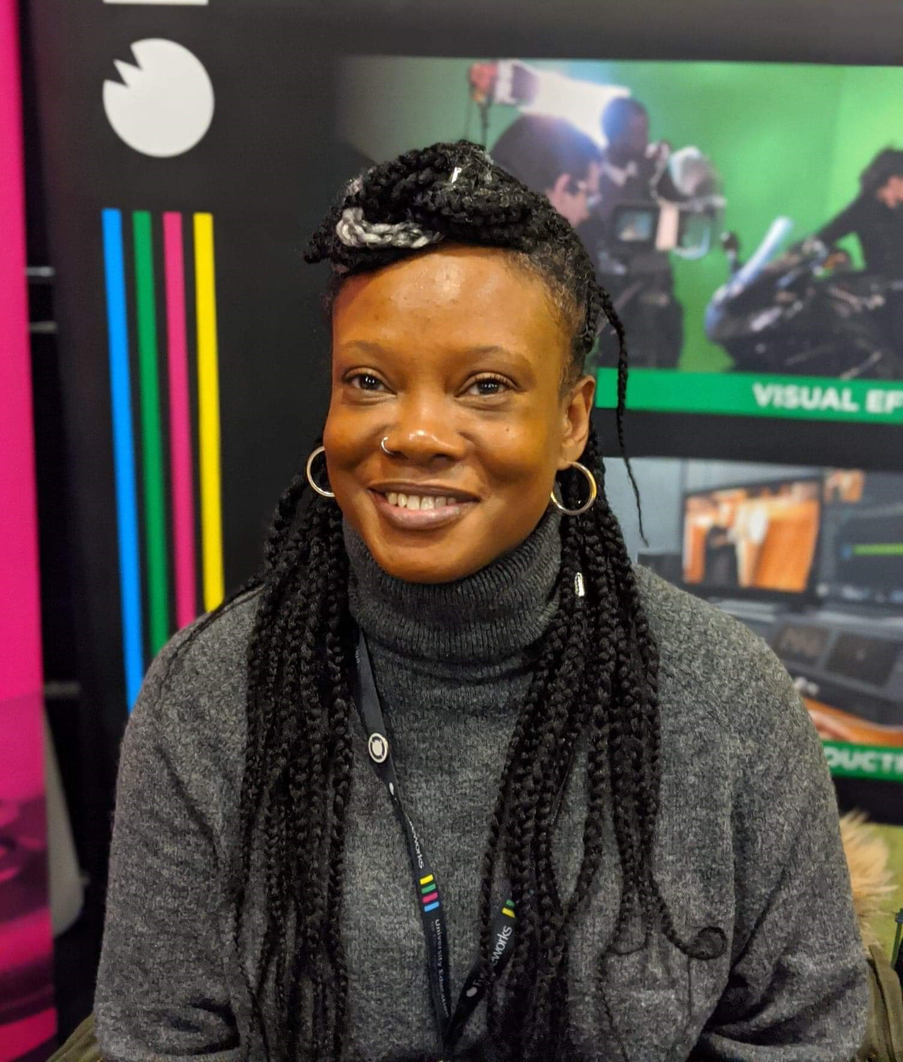
Lorraine Ballintine
Mentoring to Widen Access - Working Group – Co-Chair

Slide 8
Current Role
Widening Participation Officer
Futureworks – Independent Higher Education Institution – Creative Industries - Manchester
2 years as the Student Welfare Officer
Coming up to 2 years as the Widening Participation Officer

Slide 9
Additional Roles
GAM (Global Arts Manchester) CiC - Co-Founder & Director
MIF (Manchester International Festival) - Peoples Forum Member
VOIC (Victims of Image Crime) – Counsellor
BACP (British Association for Counsellors and Psychotherapy) – Member
NEON –Mentoring to Widen Access Co-Chair

Slide 10
Educational Support Journey
Learning Support Worker - Secondary Education
Learning Mentor - FE
Learning Mentor - Trafford Council KS3/4 – Pupil Referral Unit
Notes:
My journey in educational support has been due to my skills and inclination towards listening and care giving with a strong sense of creativity.

Slide 11
Mentoring
I believe that great mentors give confidence to those who need it and I am willing to invest in relationships to learn and develop ways of mentoring that can widen access to Higher Education.

Slide 12
Breakout room
As we move along each Government’s Covid-19 road map for the easing of restrictions. How are you planning to make changes to your mentoring programme?
What plans do you have to return to in person activity?
What elements of your current practice or delivery models are you intending on embedding?
Is there anything that you wish to do differently?

Slide 13
Next Steps
Sign up to use TEAMs
Date of next meeting: 23rd June 2021
Contact details
Lorraine Ballintine: lorraine.ballintine@futureworks.ac.uk
Trish Nicolaides: Trish.Nicolaides@soton.ac.uk

